Slide 1



SMART INDIA HACKATHON 2026
TITLE PAGE
  Problem Statement ID –
  Problem Statement Title-AI-Based Verification and Routing System for Crop Insurance Claims under PMFBY
  Theme-Smart Automation
  PS Category - Software
  Team ID-
  Team Name -
Team Cadbury

Slide 2
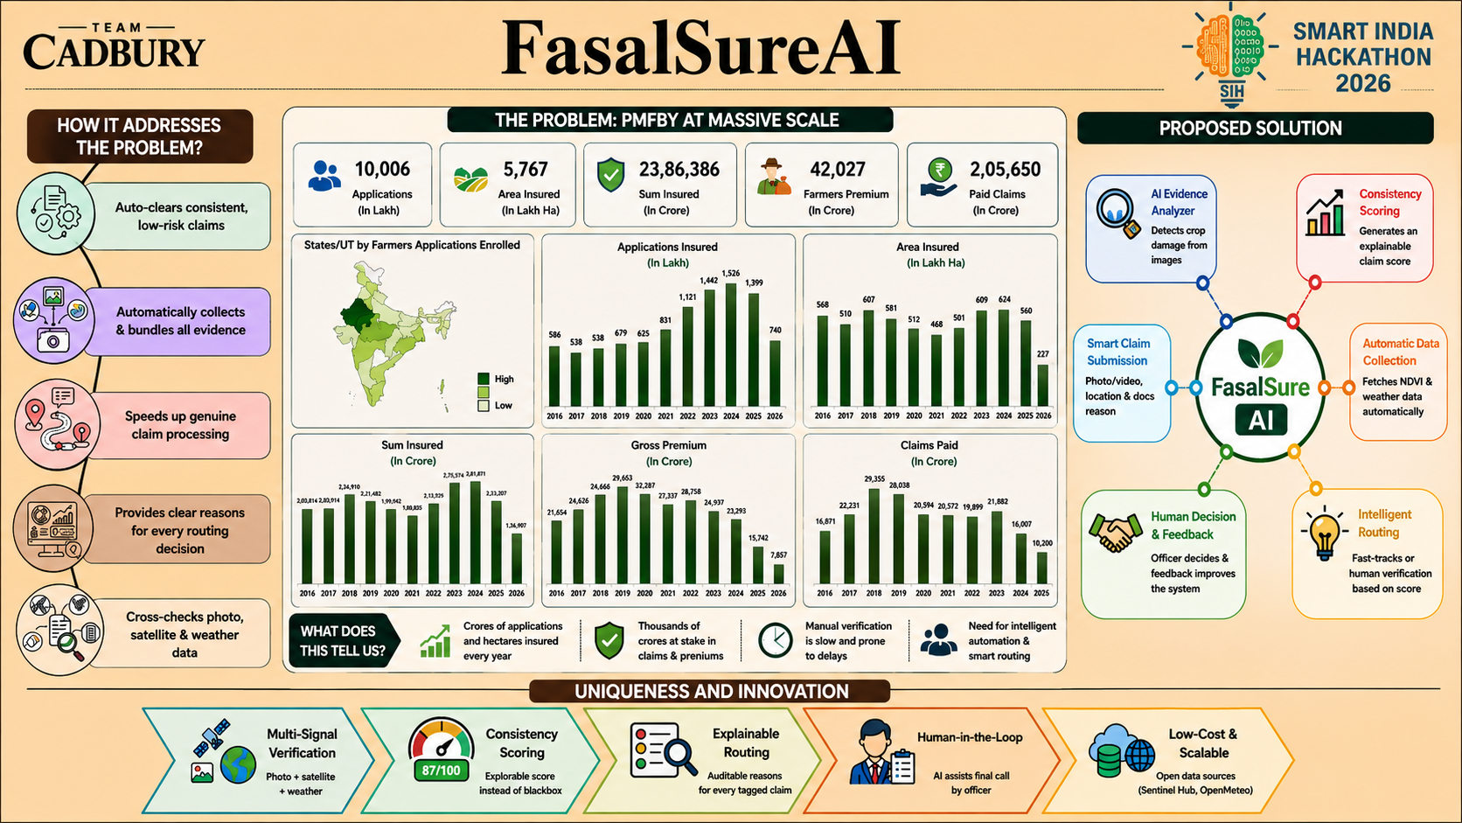

Slide 3
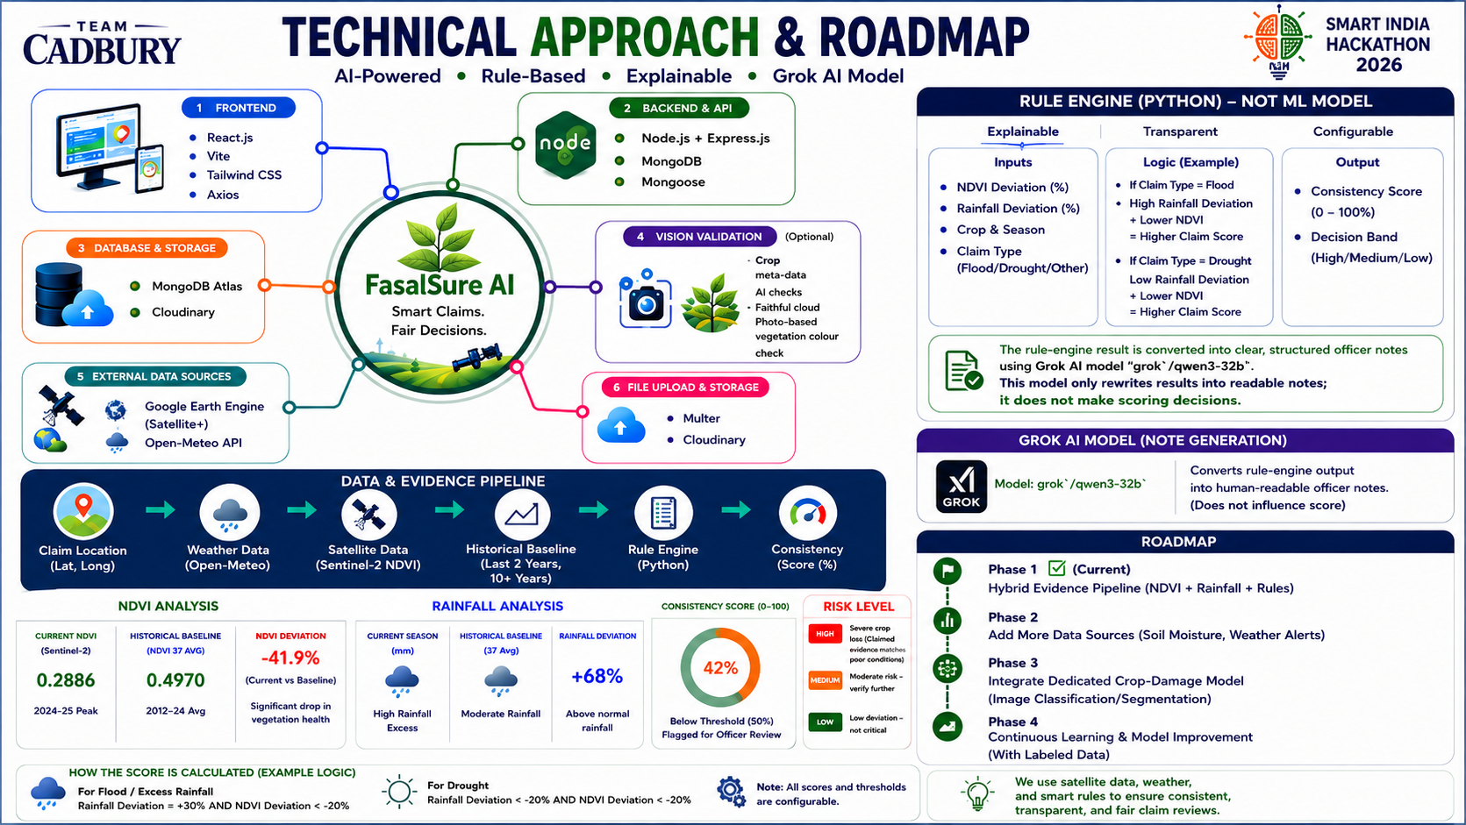
Notes:
3

Slide 4

Notes:
4

Slide 5

Notes:
5

Slide 6
